Slide 1
University lecture timetable scheduling

Slide 2
Introduction
Introduction
Motivation
University lecture timetable scheduling
What is?
Objectives
Generate timetable with no conflicts and satisfy users' requirements.
Optimize the obtained schedules.
Reduce time and effort to create timetables.
Related work
Making a School Schedule from GOV.SA
Scheduly

Slide 3





Application Plan
Platform
Algorithm
What is Genetic Algorithms?

Slide 4
How Genetic Algorithms Work?

Slide 5
Users of the system
Administrator of the system
Head of the department
College secretary

Slide 6
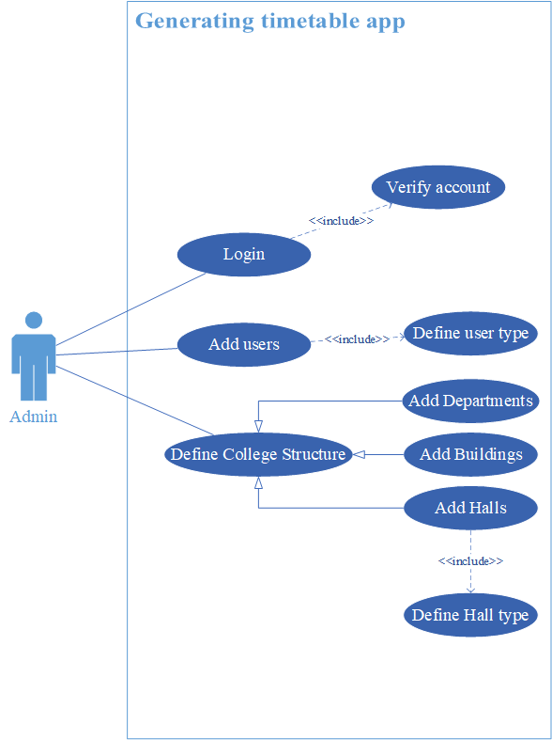
Administrator use case

Slide 7
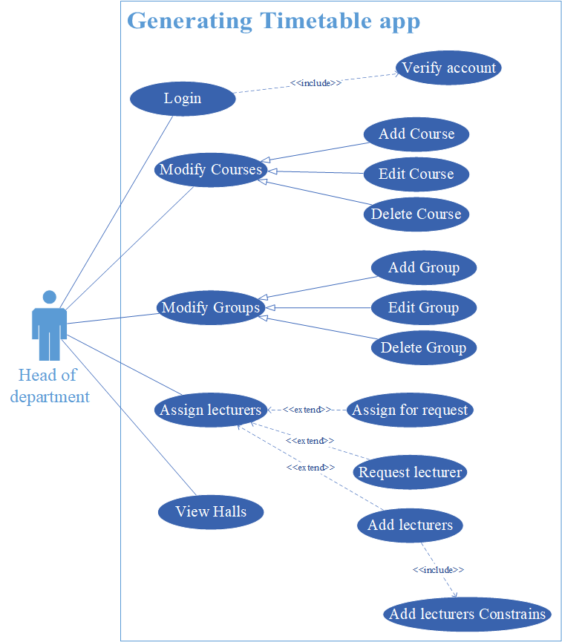
Head of the department use case

Slide 8
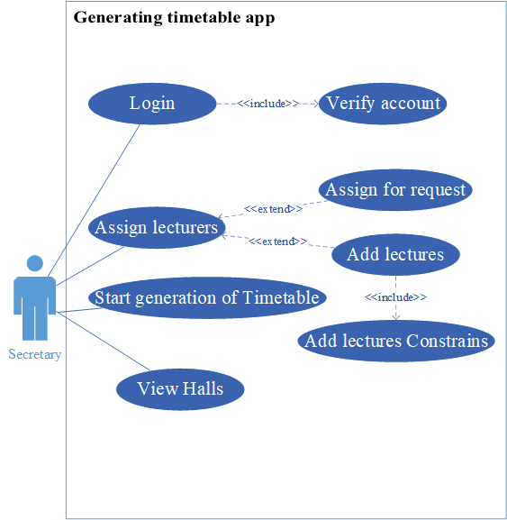
College secretary use case

Slide 9
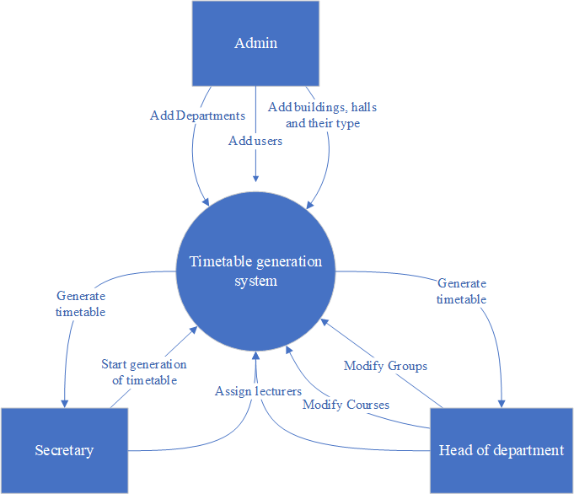
Context diagram

Slide 10
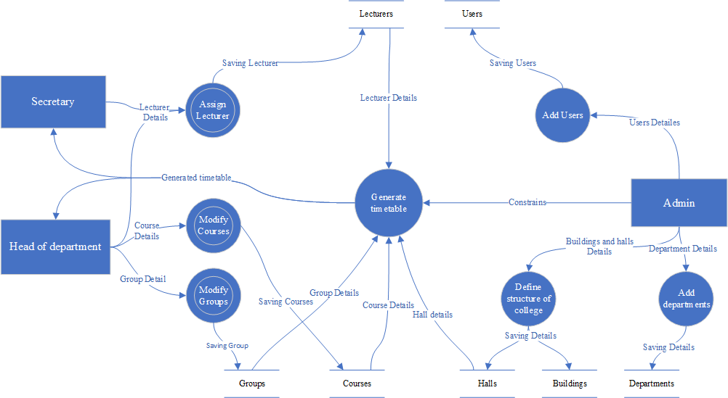
Dataflow diagram

Slide 11
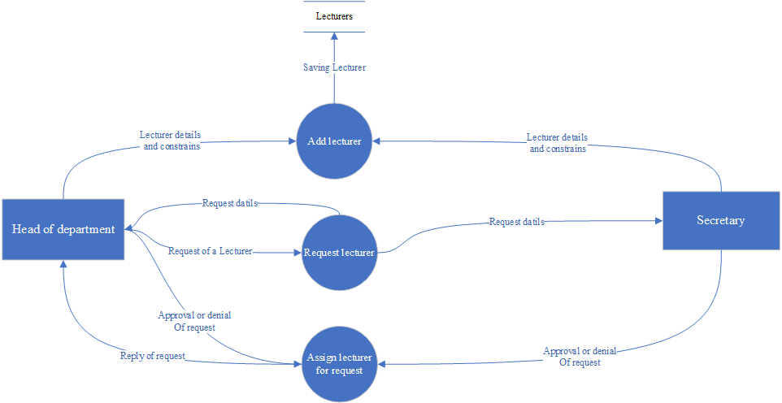
Dataflow diagram of multiple process

Slide 12
Entity relationship diagram

Slide 13
